Slide 1

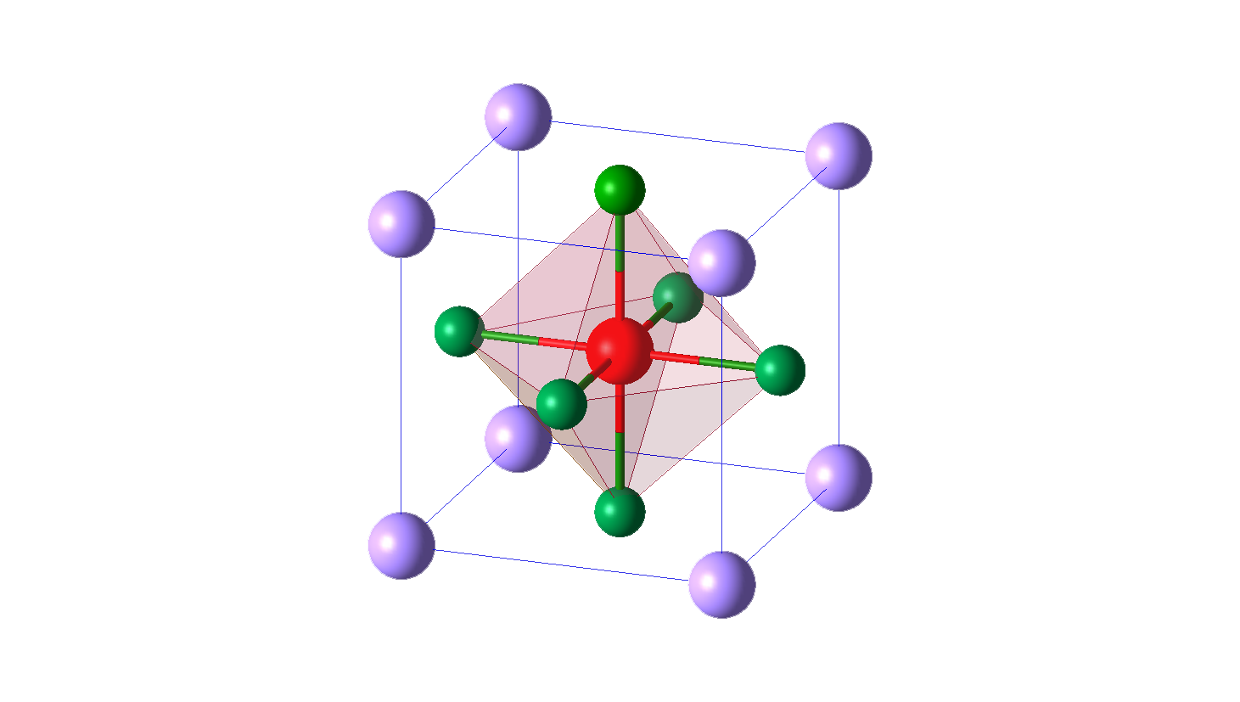

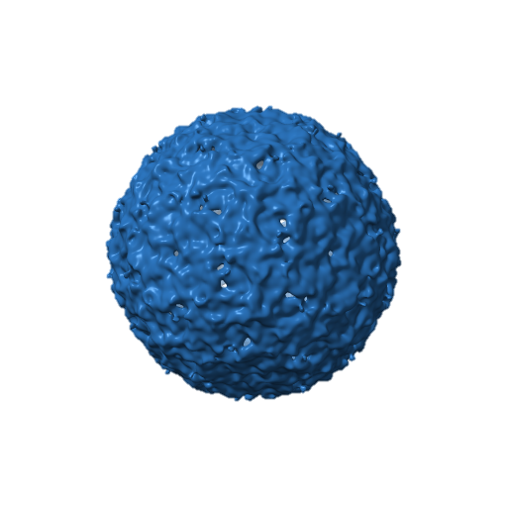

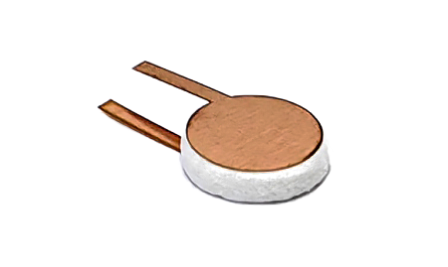
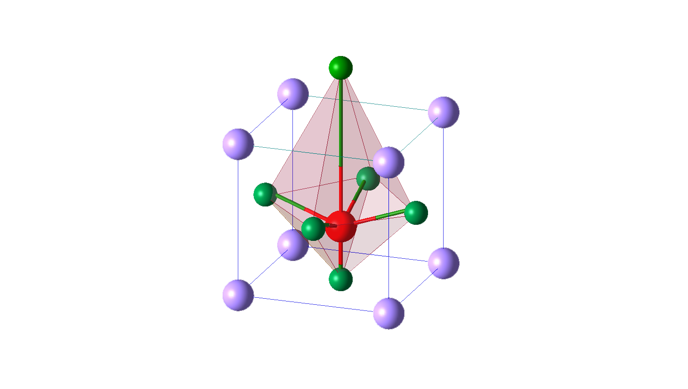

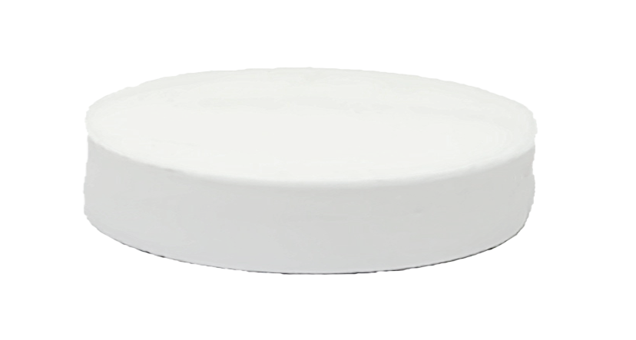

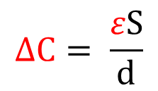

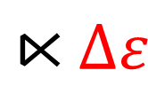

(a)
$$S$$
(b)
(c)
Patch
Ba²⁺
6mm
Ti⁴⁺
$$ε$$
$$d$$
O²⁻
Temperature Sensor
Temperature increasing
$$⋉∆ε$$
Ba²⁺
6mm
Ti⁴⁺
BaTiO₃
@PDMS
$$∆C= \frac{εS}{d}$$
O²⁻
SEM of the BaTiO3
Notes:
Orientation
Single tag

Slide 2






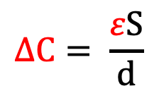

(a)
$$S$$
(b)
(c)
Patch
Ba²⁺
6mm
Ti⁴⁺
$$ε$$
$$d$$
O²⁻
Temperature Sensor
Temperature increasing
$$⋉∆ε$$
10mm
Ba²⁺
Ti⁴⁺
BaTiO₃
@PDMS
$$∆C= \frac{εS}{d}$$
O²⁻
SEM of the BaTiO3
Notes:
Orientation
Single tag

Slide 3



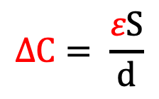

Patch
Ba²⁺
$$S$$
6mm
Ti⁴⁺
$$ε$$
$$d$$
O²⁻
Temperature Sensor
Temperature increasing
$$⋉∆ε$$
10mm
Ba²⁺
BaTiO₃
@PDMS
Ti⁴⁺
$$∆C= \frac{εS}{d}$$
O²⁻
SEM of the BaTiO3
Notes:
Orientation
Single tag

Slide 5
6mm
10mm
1mm
10mm
BaTiO₃@pdms
Patch
Temperature
sensor

Slide 6
6mm
10mm
10mm
1mm
BaTiO₃@pdms
Patch
Temperature
sensor

Slide 7
6mm
1mm
10mm
BaTiO3@
PDMS
Temperature Sensor
Patch

Slide 8
6mm
1mm
10mm
BaTiO₃
@PDMS
Temperature Sensor
Patch

Slide 9
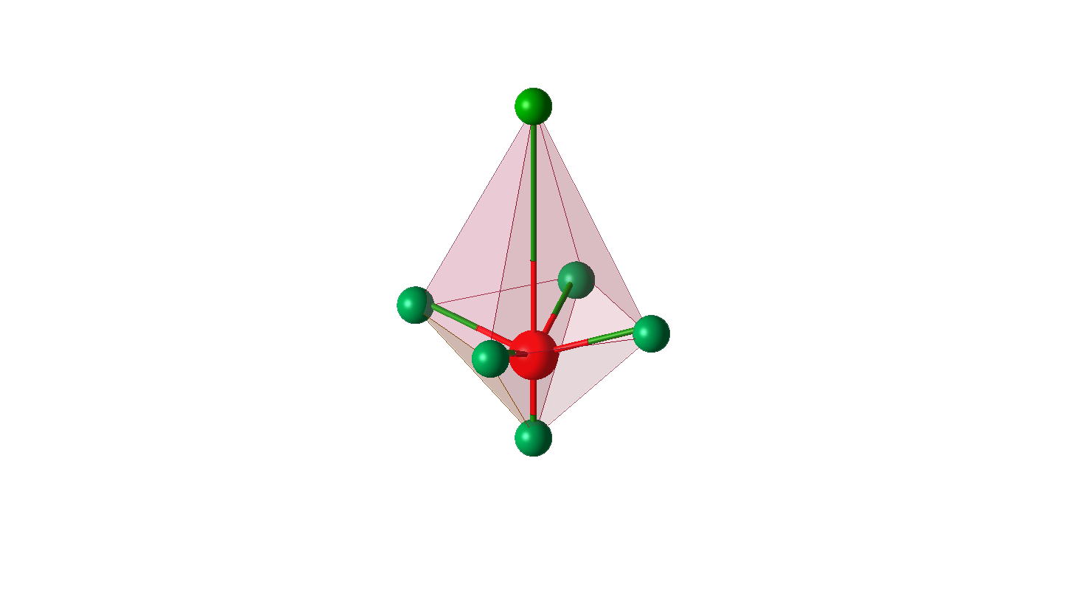
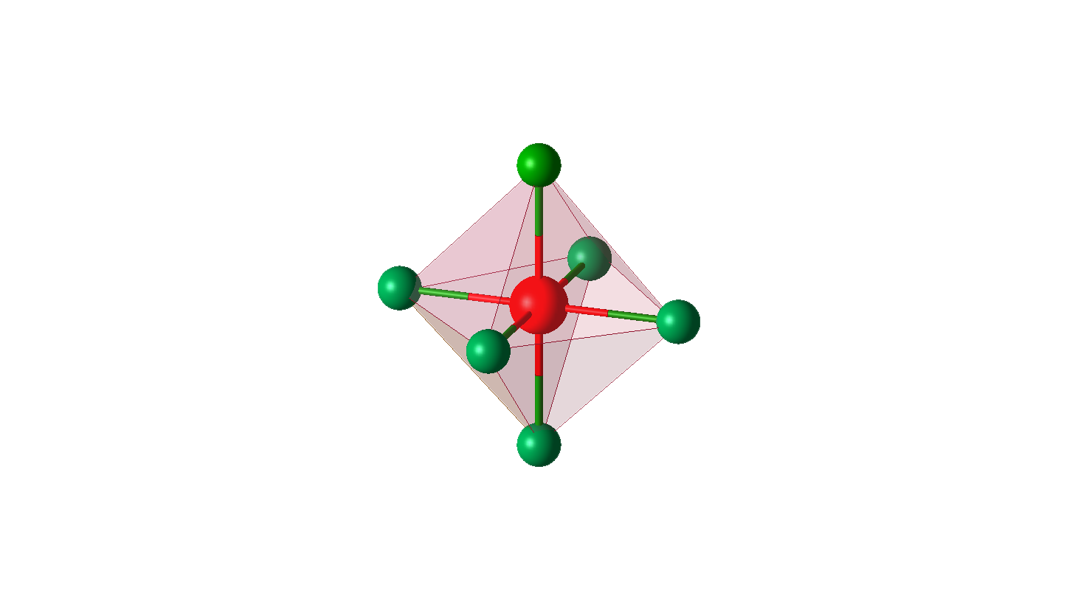

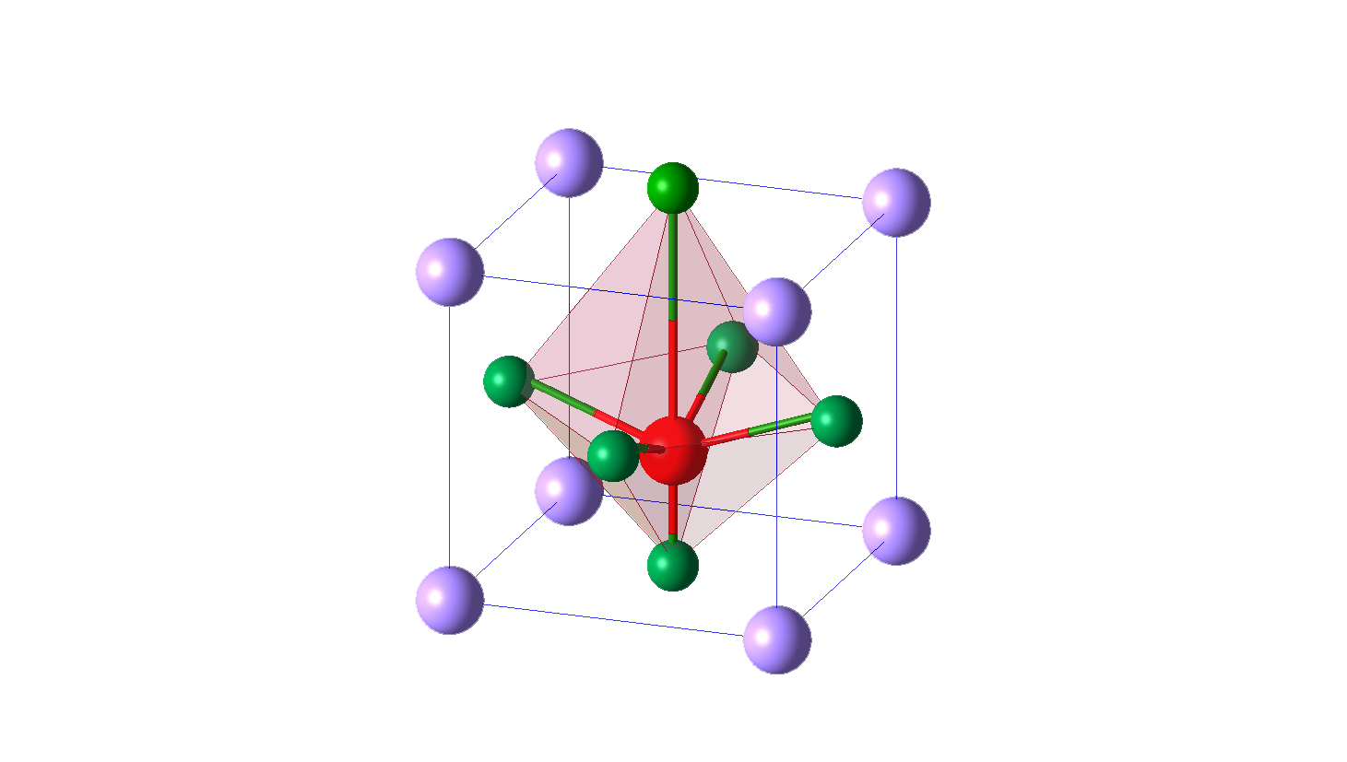

Patch
Ba²⁺
6mm
Ti⁴⁺
Temperature Sensor
O²⁻
$$ε$$
After heating
Varies
Ba²⁺
10mm
Ti⁴⁺
BaTiO₃
@PDMS
O²⁻
SEM of the BaTiO3
Notes:
Orientation
Single tag

Slide 10
Patch
Ba²⁺
6mm
Ti⁴⁺
Temperature Sensor
O²⁻
$$ε$$
After heating
Varies
Ba²⁺
10mm
Ti⁴⁺
BaTiO₃
@PDMS
O²⁻
SEM of the BaTiO3
Ba²⁺
Ba²⁺
Ti⁴⁺
Ti⁴⁺
O²⁻
O²⁻
Notes:
Orientation
Single tag

Slide 11
Electric Field E
Electric Field E
Strong internal electric field
Concentration
(b)
(c)

Slide 12


Slide 14
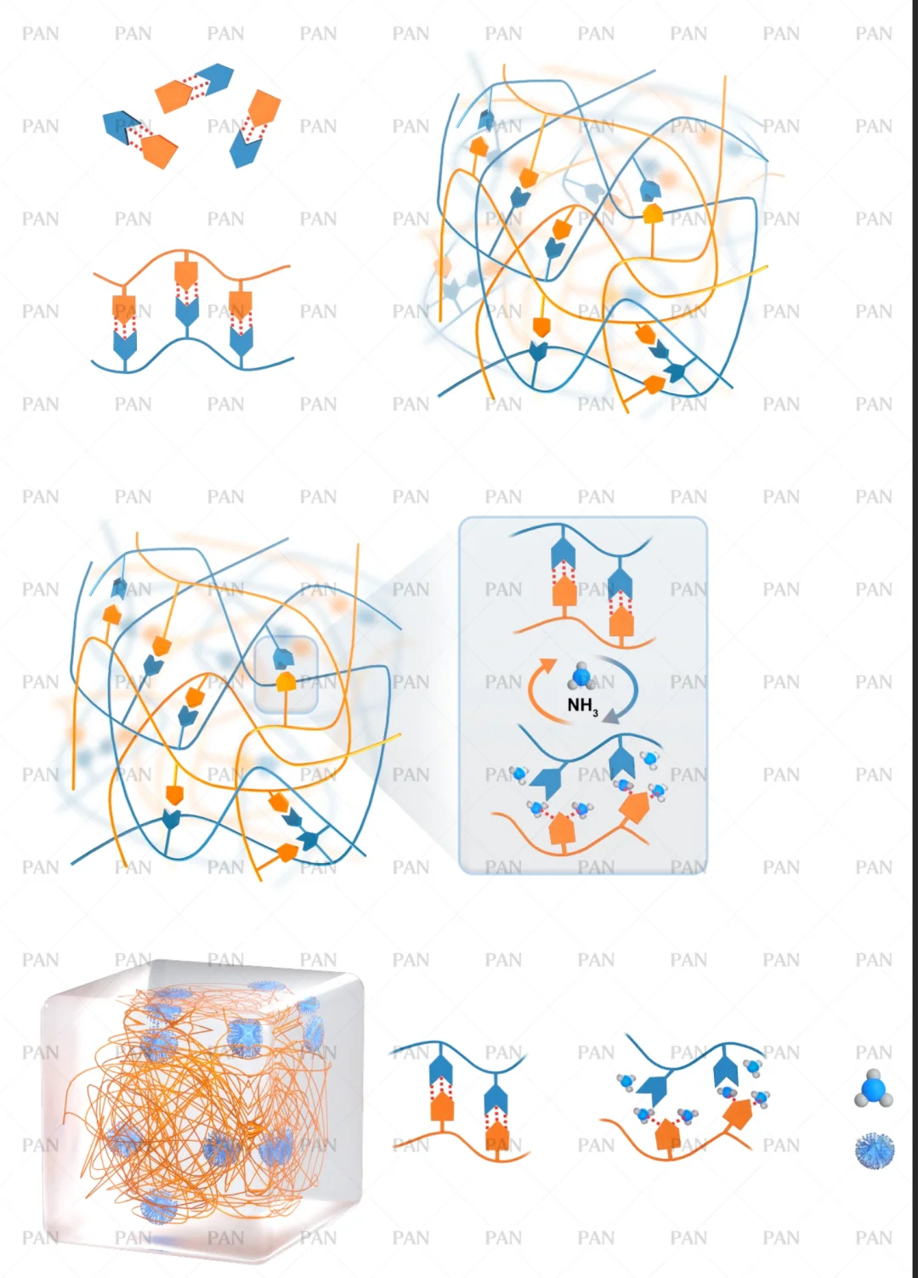
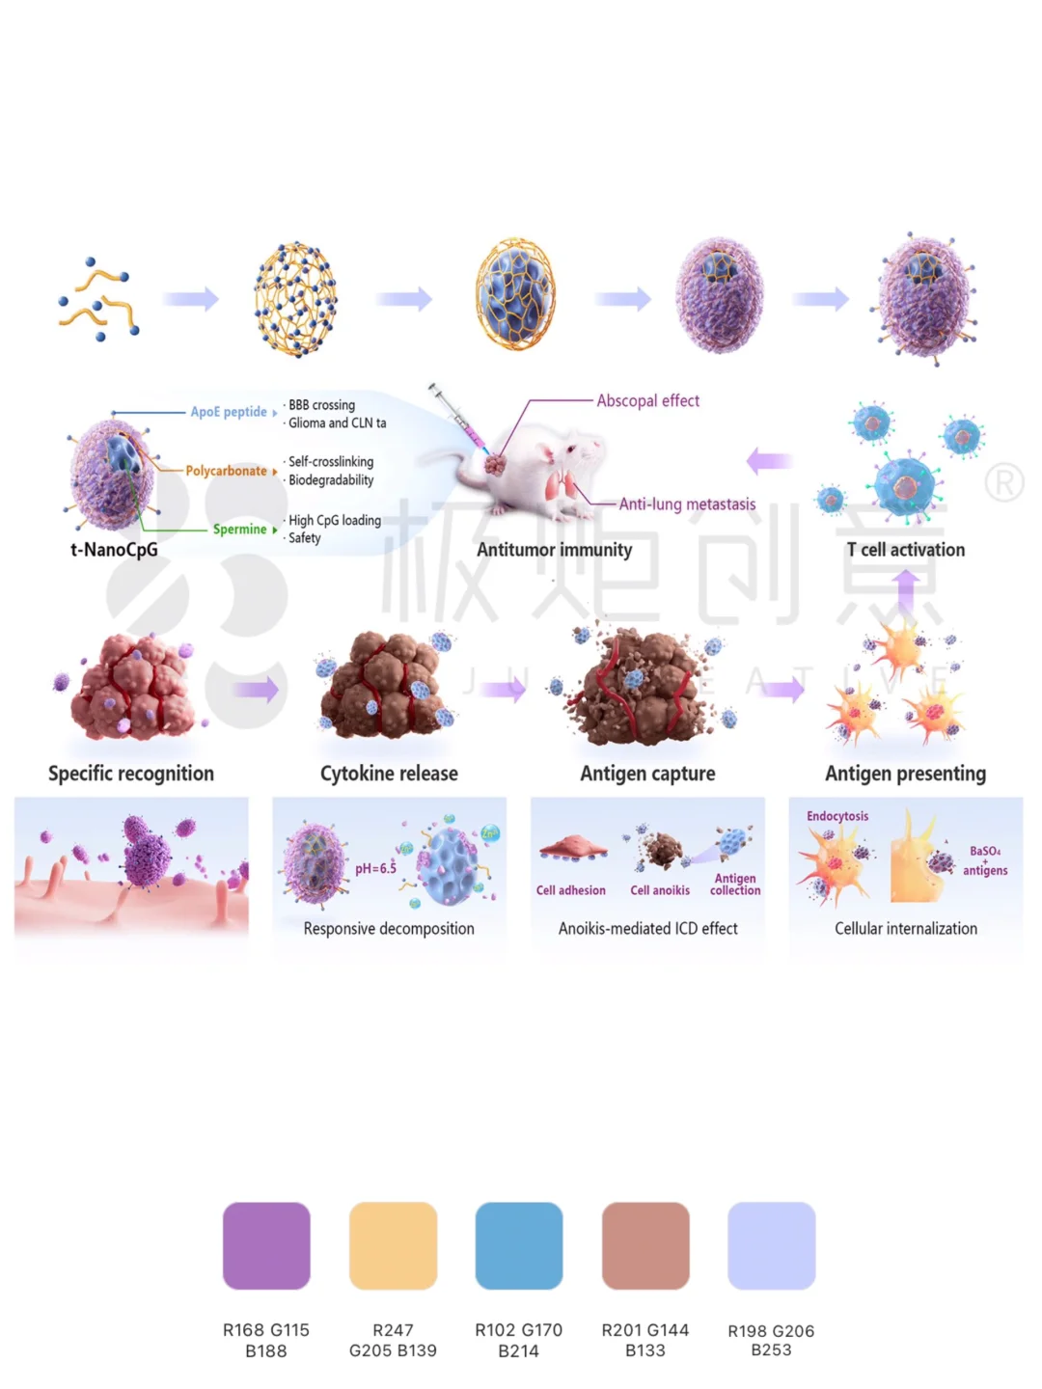

Slide 15
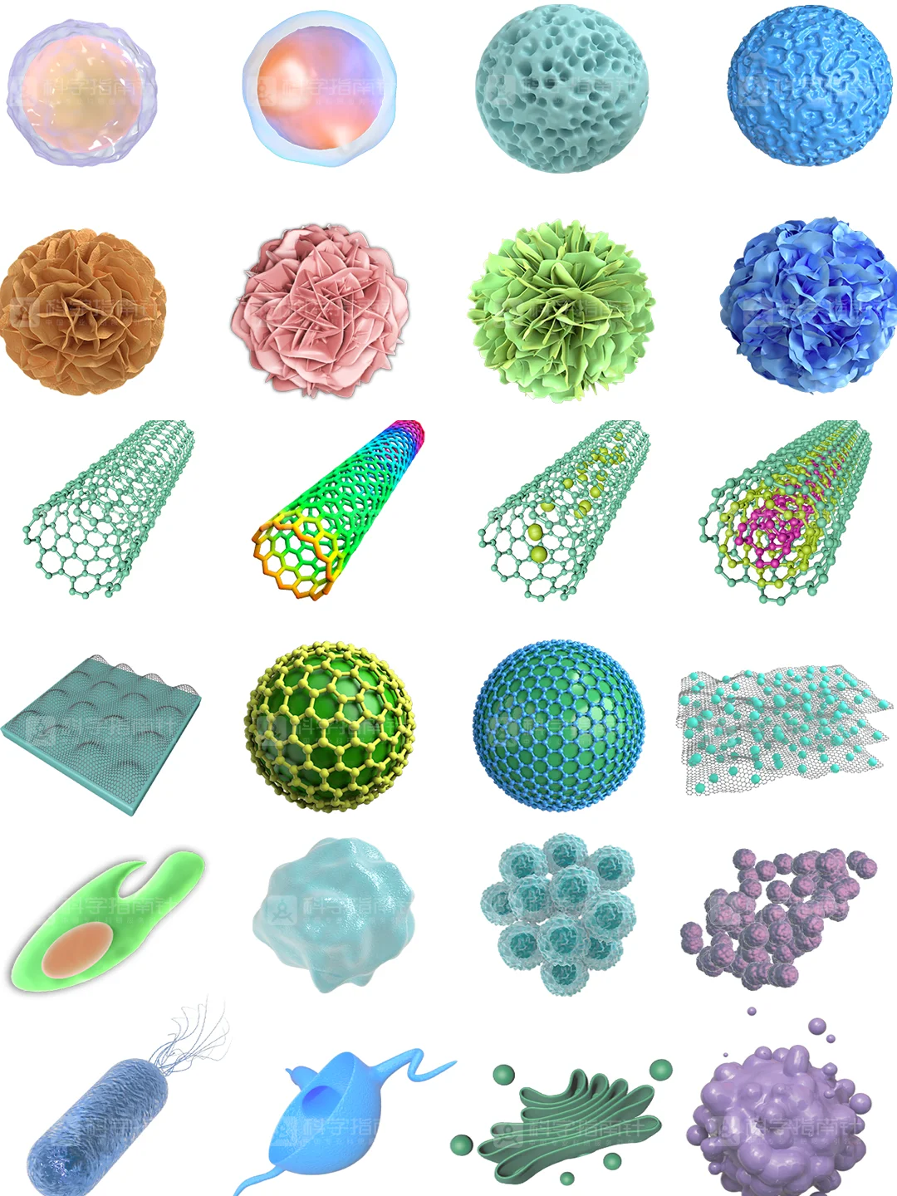


Slide 16


Slide 18
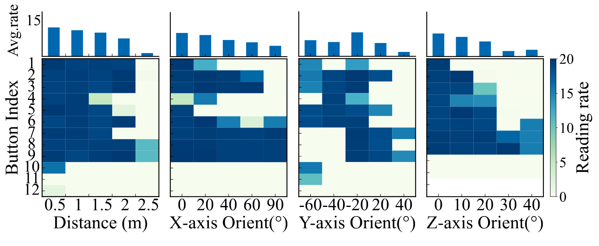
Z
Y
X

Slide 19
Z
Y
X
X-Axis
Z-Axis
Y-Axis

Slide 23
